Slide 1

Project partners:
Idrees 12508
Amir 12560
Presented to Sir Shehzad Saifullah

Slide 2
Expense Tracking Made Easy
INTRODUCTION:
Introducing an intuitive expense tracking system that streamlines your financial management. Gain control over your spending, optimize budgets, and make data-driven decisions to achieve your financial goals.

Slide 3
Challenges in Expense Management
1
Disorganized Records
2
Lack of Visibility
Scattered receipts and inconsistent record-keeping make it difficult to track expenses accurately.
Without a centralized system, it's a challenge to gain a comprehensive overview of your spending habits.
3
Inefficient Reimbursement
4
Budgeting Struggles
Manual expense reporting and approval processes can be time-consuming and error-prone.
Difficulty in categorizing and analyzing expenses impedes effective budget planning and management.

Slide 4
Project Scope
Core Features
Integrations
Intelligent Insights
Intuitive expense entry, automatic categorization, and real-time reporting.
Seamless integration with banking and accounting platforms for streamlined data flow.
Advanced analytics and smart recommendations to optimize spending and budgets.

Slide 5

Features and Functionalities
Expense Tracking
Automated Workflows
Easily log, categorize, and manage all your expenses in one centralized platform.
Streamline expense approval processes and enable seamless reimbursement.
1
2
3
Reporting and Analytics
Gain valuable insights through comprehensive reports and customizable dashboards.

Slide 6




Target Audience
Small Businesses
Employees
Accounting Professionals
Frequent Travelers
Empower small business owners to better manage their finances and optimize spending.
Provide a user-friendly tool for employees to easily track and report expenses.
Assist accountants and finance teams in streamlining expense management processes.
Offer a comprehensive solution for individuals who need to manage complex travel expenses.

Slide 7
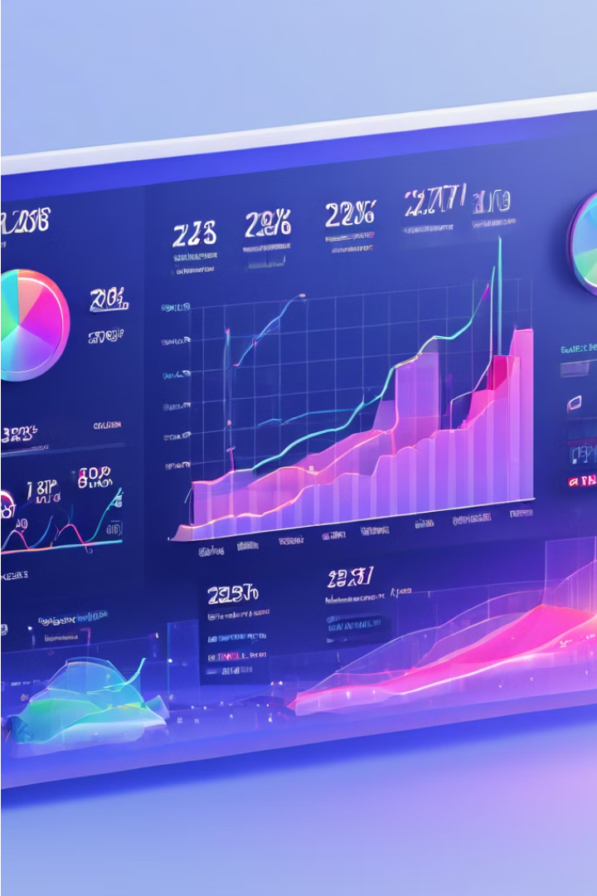
ABOUT OUR PROJECT
DASHBOARD:
1) First there is intro to our Dashboard which shows Up-Down Graph According to the Price of the Product, Below of the Graph there are some sections for each product which shows the product details.

Slide 8

ABOUT OUR PROJECT
SIDE BAR:
There is some options to click Like Dashboard, Categories, Expense and settings.

Slide 9
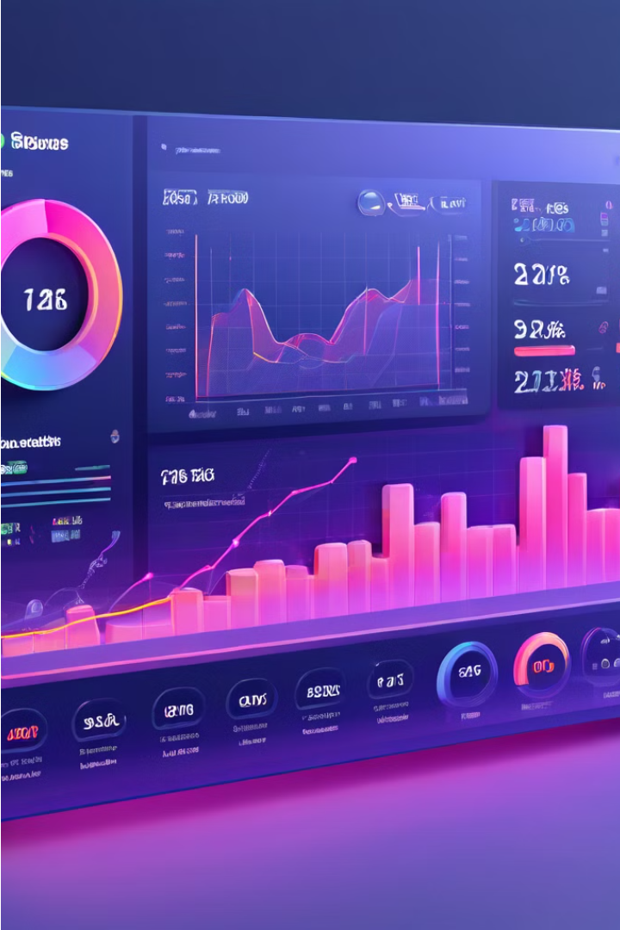
EXPENSE FIELD
We can add, remove and update the expenses.

Slide 10
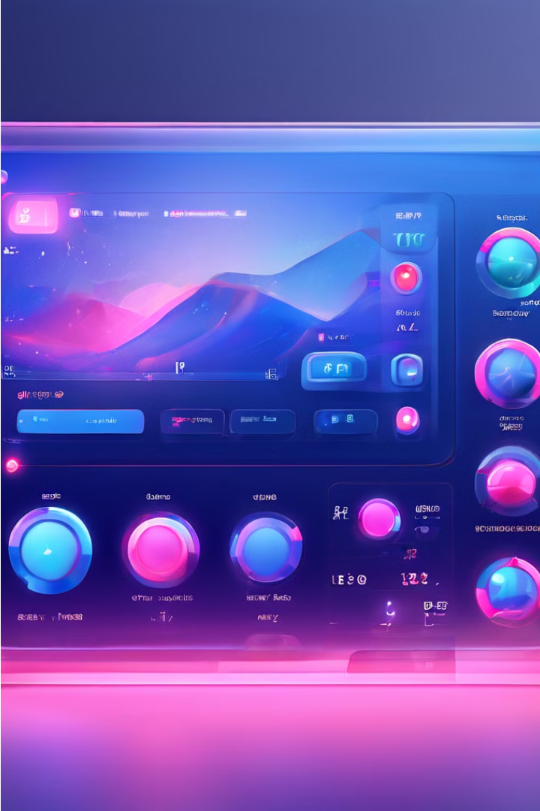
Expense View system
Here in this section the whole record for expense is shown, With some details like Designation, Categories, Amount, and Date.

Slide 11
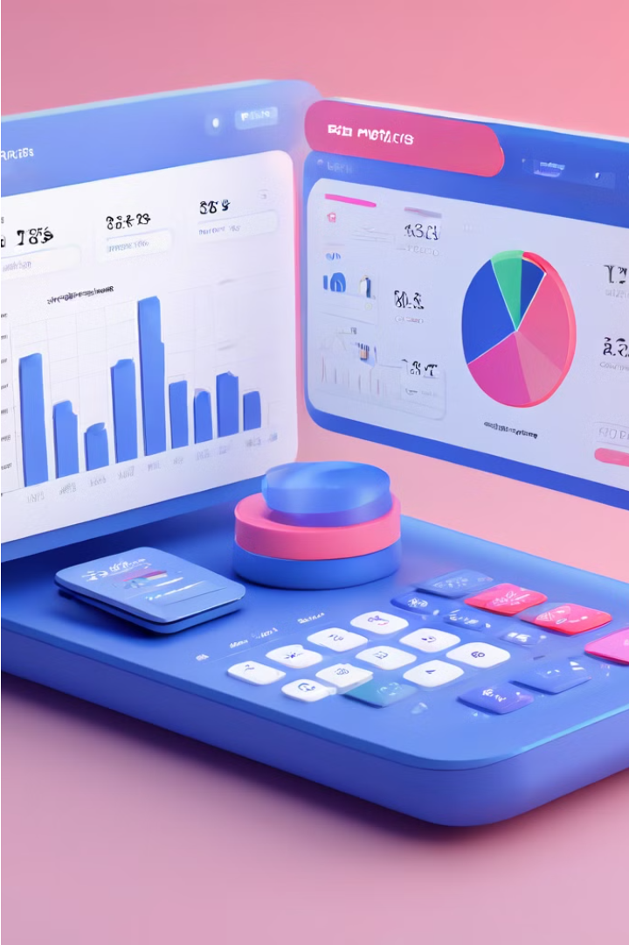
SETTINGS FIELDS:
In This Field the user can set everything according to there need , login an d logout option is also available here.

Slide 12
THANK YOU!

